Slide 1
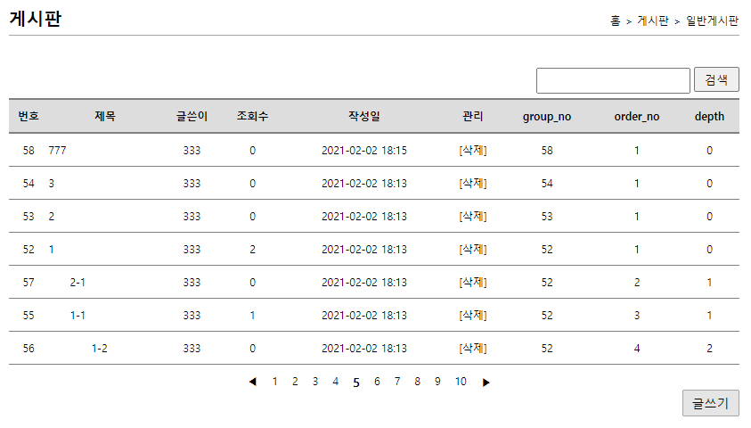
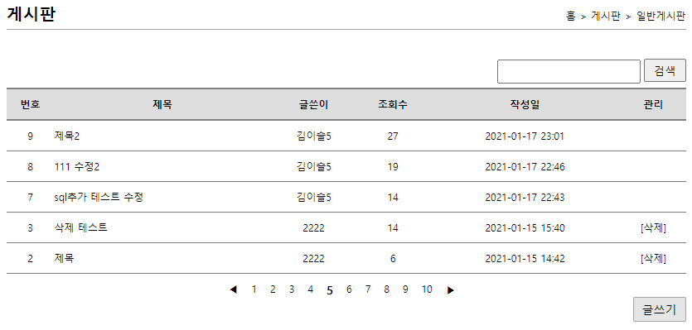
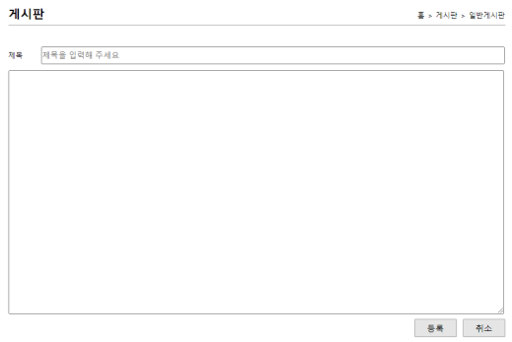
계층형 게시판
00
사용자
jsp
controller
service
dao
sqlSession
xml
1. list(게시판 리스트)
alias=CommentVo
/comment/list
List<CommentVo>
commentList()
List<CommentVo>
commentList()
selectList
(“comment
.commentList”)
id="commentList" resultType
="CommentVo"
/list
list(Model model)
list.jsp
commentList
commentList
commentList
포워드
CommentVo
model.addAttribute(“cList", commentList);
2.writeForm(새글쓰기폼)
/comment/writeForm
/writeForm
writeForm()
writeForm.jsp
포워드

Slide 2

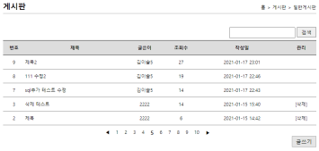
00
계층형 게시판
사용자
jsp
controller
service
dao
sqlSession
xml
no=0,
title=333, name=null, content=333, hit=0,
date=null, user_no=8
commentVo
3.write(새 글쓰기 등록)
no=0,
title=333, name=null, content=333, hit=0,
date=null, user_no=0
int no = ((UserVo)session.getAttribute("authUser")).getNo();
boardVo.setUser_no(no) // vo에user_no값 추가
/comment/write?title=333&content=333
/write
write(@ModelAttribute
CommentVo commentVo,
HttpSession session)
commentVo
commentVo
commentVo
commentVo
/comment/write
write(CommentVo
commentVo)
commentInsert
(CommentVo
commentVo)
insert(“comment.commentInsert,
commentVo)
id=“boardInsert"
resultType=“CommentVo"
redirect:/comment/list
리다이렉트
4. remove(삭제)
/comment/remove?no=8
no=8
no=8
/board/remove
no=8
no=8
no=8
/remove
remove(int no)
remove(int no)
commentDelete
(int no)
delete (“comment
.commentDelete",no)
id="commentDelete"
parameterType="int"
redirect:/comment/list
리다이렉트

Slide 3
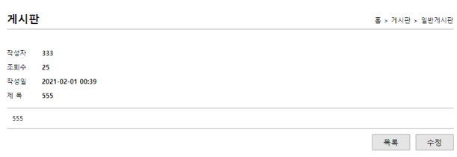
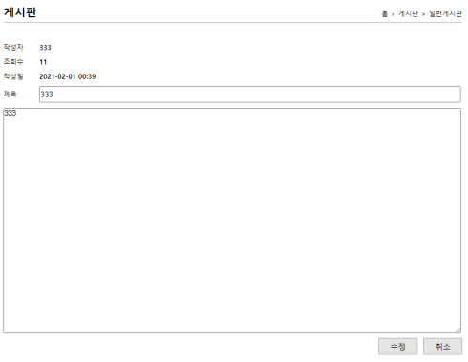
계층형 게시판
00
사용자
jsp
controller
service
dao
sqlSession
xml
5.read(글읽기)
no
no
no
commentHit(no)
update(“comment.
commentHitUpdate”, no)
id="commentHitUpdate"
parameterType="int"
/comment/read?no=8
/read
read(@RequestParam("no") int no,
Model model)
no
/comment/read
read(int no)
no
포워드
no
no
id="commentOne"
parameterType="int"
resultType
="CommentVo"
read.jsp
commentVo
commentOne(no)
selectOne(“comment.
commentOne“, no)
model.addAttribute(“commentOne", commentService.read(no));
commentVo
commentVo
commentVo
6. modifyForm(수정폼)
/comment/modifyForm?no=8
no=8
no
no
/comment/modifyForm
/modifyForm
modifyForm(@RequestParam("no")
int no, Model model)
no
no
selectOne(“comment.
commentOne“, no)
id="commentUpdate“
parameterType
="CommentVo"
modifyRead(int no)
commentOne(no)
modifyForm.jsp
commentVo
commentVo
commentVo
포워드
commentVo
model.addAttribute("boardOne", boardService.read(no));
no=11, title=333, name=333, content=333, hit=8, date=2021-02-01 00:39, user_no=8

Slide 4
계층형 게시판
00
사용자
jsp
controller
service
dao
sqlSession
xml
commentVo
7. modify(수정)
no=11, title=555, name=null, content=555, hit=0, date=null, user_no=0
/comment/modify?no=8&title=555&content=555
/comment/modify
commentVo
commentVo
commentVo
commentVo
/modify
modify(@ModelAttribute
CommentVo commentVo)
modify(CommentVo
commentVo)
commentUpdate
(CommentVo
commentVo)
update(“comment.
commentUpdate“,commentVo)
id="boardUpdate"
parameterType
="BoardVo"
"redirect:/comment/list"
리다이렉트
8.commentForm(댓글폼)
read 페이지에서 로그인 상태에서만 버튼이 보임
/comment/commentForm?group_no=5&order_no=1&depth=1
/comment/commentForm
/commentForm
commentForm()
commentForm.jsp
포워드

Slide 5
계층형 게시판
00
사용자
jsp
controller
service
dao
sqlSession
xml
commentVo
commentVo
no=0, user_no=8, title=22, content=22, hit=0, reg_date=null, group_no=58, order_no=1, depth=1
no=0, user_no=0, title=22, content=22, hit=0, reg_date=null, group_no=58, order_no=1, depth=1
9.commentWrite(댓글쓰기)
commentVo
id="orderNoUpdate" parameterType="CommentVo"
int no = ((UserVo)session.getAttribute("authUser")).getNo();
commentVo.setUser_no(no) // vo에user_no값 추가
orderNoUpdate
(CommentVo
commentVo)
update
("comment.orderNo
Update“,commentVo)
/comment/commentWrite?title=33&content=33
commentVo
/comment/commentWrite
/commentWrite
commentWrite(@ModelAttribute
CommentVo commentVo,
HttpSession session)
commentVo
commentWrite
(CommentVo
commentVo)
commentVo
redirect:/comment/list
리다이렉트
commentVo
commentVo
commentTowInsert
(CommentVo
commentVo)
insert("comment.second
CommentInsert“,
commentVo)
id="secondCommentInsert"
parameterType
="CommentVo"

